Slide 1
GIS Lesson 4
Introduction to Temporal Data
時間數據簡介
2020/5/20

Slide 2
Agenda
1. Introduction to Temporal Data 時間數據簡介
A. What is Temporal Data? 甚麼是時間數據？
Definitions 定義
Examples 例子
B. How to Store Temporal Data? 如何儲存時間數據?
C. How to Visualize Temporal Data? 如何顯示時間數據?
2. Tutorial 個別指導

Slide 3

A. What is Temporal Data? 甚麼是時間數據？
Notes:
Picture Source: https://www.google.com/url?sa=i&url=https%3A%2F%2Fwww.networkworld.com%2Farticle%2F3481602%2Fdisplaying-dates-and-times-your-way-in-linux.html&psig=AOvVaw016H9CoYGQamRsr94jkAS3&ust=1590718751521000&source=images&cd=vfe&ved=0CAMQjB1qFwoTCMDztqe_1ekCFQAAAAAdAAAAABAU

Slide 4
Recap…
Notes:
Not only spatial but also temporal data contained in GIS

Slide 5
Definition of Temporal Data 時間數據的定義
Temporal data is simply data that represents a state in time (ESRI, 2016)
Translation: 時間數據只是表示時間狀態的數據
In other words, temporal data shows data at certain time points
Examples
Land-use patterns (土地用途模式) of Hong Kong in 1990 (ESRI, 2016)
Total precipitation (總降雨量) in Toronto in 2019
Forest fire hotspots (山火熱點) in British Columbia in 2017
Notes:
Source: https://desktop.arcgis.com/en/arcmap/10.3/map/time/what-is-temporal-data.htm

Slide 6
Quick Check…
Which of the following is NOT an example of temporal data?
A. Average rainfall in Southwestern Ontario in July 2010
B. Distribution of coronavirus cases in the City of Toronto
C. Location map of Typhoon Mangkhut across several days in 2018 in the Philippines
D. None of the above

Slide 7
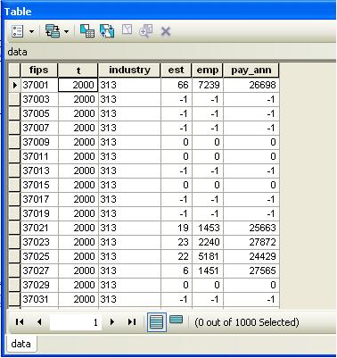
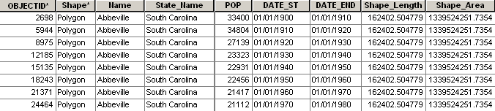
B. How to Store Temporal Data? 如何儲存時間數據?
Just add time field(s) to a spatial table
Can be one or two time fields
One time field: showing a specific time point for each row of data
Two time fields: showing a start time and an end time of a time period of each row of data
Notes:
Source: https://www.google.com/url?sa=i&url=https%3A%2F%2Fdesktop.arcgis.com%2Fen%2Farcmap%2F10.3%2Fmap%2Ftime%2Fhow-time-is-supported-in-spatial-data.htm&psig=AOvVaw0JdUmILcAmX1erhhDaSRCX&ust=1590720374662000&source=images&cd=vfe&ved=0CAMQjB1qFwoTCKDJ0anF1ekCFQAAAAAdAAAAABAO

Slide 8
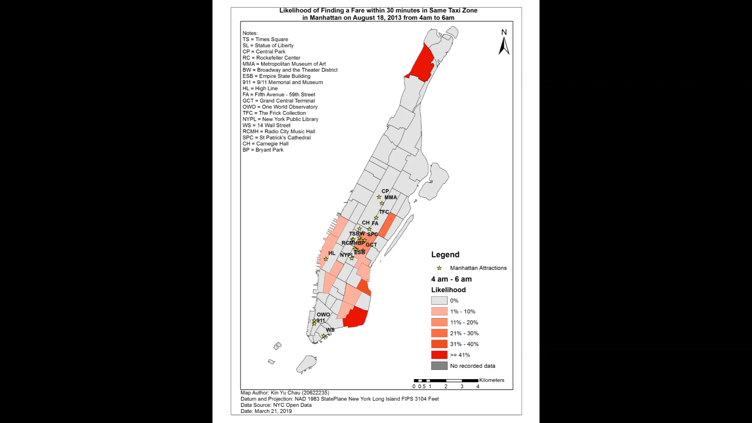
C. How to Visualize Temporal Data? 如何顯示時間數據?

Slide 9
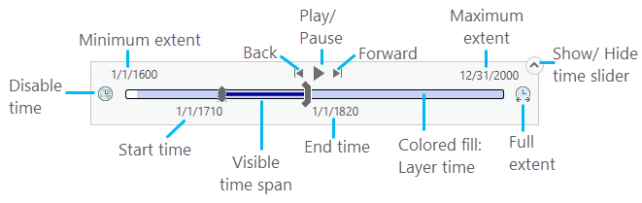
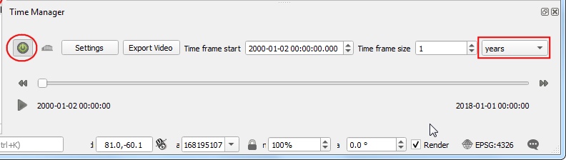
C. How to Visualize Temporal Data? 如何顯示時間數據?
ArcGIS
Using Time Slider tool
QGIS
Using TimeManager tool
Notes:
Sources:
- https://www.google.com/url?sa=i&url=https%3A%2F%2Fpro.arcgis.com%2Fen%2Fpro-app%2Fhelp%2Fmapping%2Ftime%2Fvisualize-temporal-data-using-the-time-slider.htm&psig=AOvVaw14IBZFePf7b_9ohbMQUJ6J&ust=1590721524243000&source=images&cd=vfe&ved=0CAMQjB1qFwoTCJjvoq_K1ekCFQAAAAAdAAAAABAO
-https://www.google.com/url?sa=i&url=https%3A%2F%2Fwww.qgistutorials.com%2Fen%2Fdocs%2F3%2Fanimating_time_series.html&psig=AOvVaw10kaMSthlyMR9ohxwAylLy&ust=1590721619292000&source=images&cd=vfe&ved=0CAMQjB1qFwoTCIC10f3J1ekCFQAAAAAdAAAAABAD

Slide 10
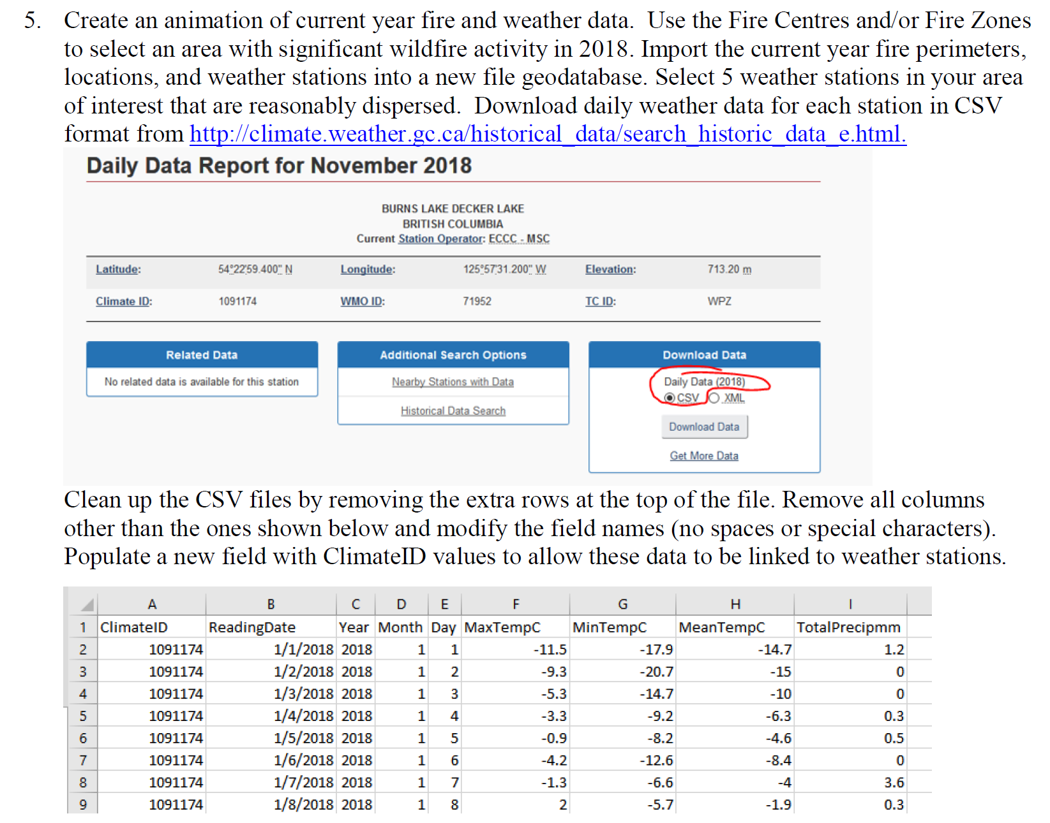
My Assignment Examples

Slide 11
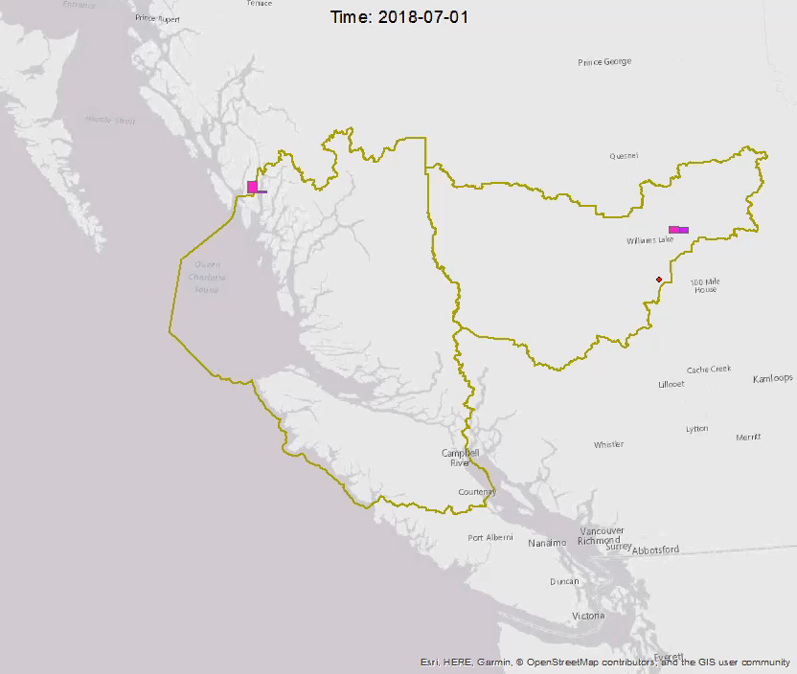

Slide 12
Questions?

Slide 13
3. Tutorial
It’s your turn!

Slide 14
Steps to visualize temporal data in QGIS
1. Plugins > Manage and Install Plugins
2. Search for TimeManager > Install Plugin
3. Plugins > TimeManager > Toggle visibility
4. Add Data
5. Field with correct format of date: YYYY-MM-DD
6. Add a basemap (e.g. Google Physical)
7. Layer Properties > Symbology > Change Map Type
8. Can also change labels (select fields that you want)
9. TimeManager > Settings > Add layer > Start time/end time choose the date field with correct format
10. Can also change show frame every x seconds (e.g. 1000 ms)

